Slide 1
Data Analysis and Presentation

Slide 2
Describing and Presenting Data
Three important criteria—accuracy, conciseness, and understandability
Researchers should always present their data in ways that most accurately represent the data
Numerical data can be classified as numerical (example: percentages, (means) or graphical (graphs) method)

Slide 3
Statistics
Three areas:
1) Descriptive – central tendency, dispersion measures
2) Relational – univariate, bivariate, or multivariate statistics
3) Inferential – difference of means, statistical significance tests

Slide 4
Measures of Central Tendency
The mean—average; most common and useful measure of central tendency; impacted by extreme scores
The median—middle score of a distribution; less affected by extreme scores (“outliers”)
The mode—most frequent score

Slide 5
Measures of Variability
Measures of Variability—descriptive statistics that convey information about the spread or variability of a set of data
Variance—a numerical index of the variability in a set of data
Standard deviation—a measure of variability that is equal to the square root of the variance
Range—the difference between the highest and lowest scores in a distribution

Slide 6
Relational Statistics
1) univariate – study of one variable for a subpopulation (ex: age of murderers)
2) bivariate – study of relationship between two variables (ex: correlation)
3) multivariate – study of relationship between three or more variables (ex: multiple correlation)

Slide 7
Frequency Distributions
A table that summarizes raw data by showing the number of scores that fall within each of the categories
Pounds Lost by Dieter | Frequency
0 | 5
1-5 | 10
6-10 | 15
Over 10 | 5

Slide 8
Frequency Histograms and Polygons
Sometimes information in frequency distributions is more easily grasped when it is presented graphically
Histogram is used when horizontal (x-axis) variable is measured on an interval or ratio scale (bars on graph touch each other)
If data is nominal or ordinal, the bars do not touch each other and it is a bar graph

Slide 9
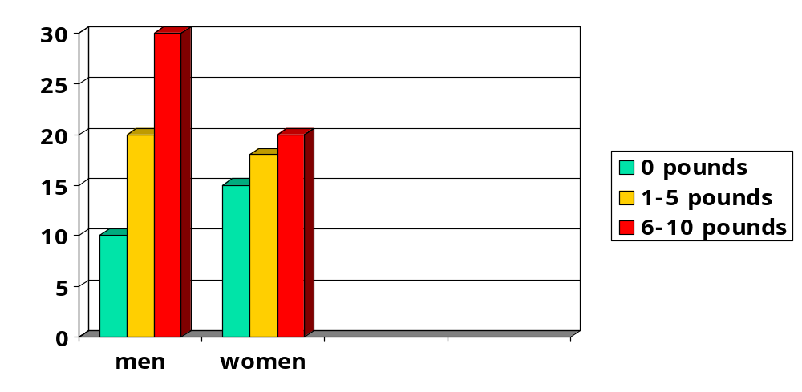
Graphical Methods of Reporting Data

